Slide 1
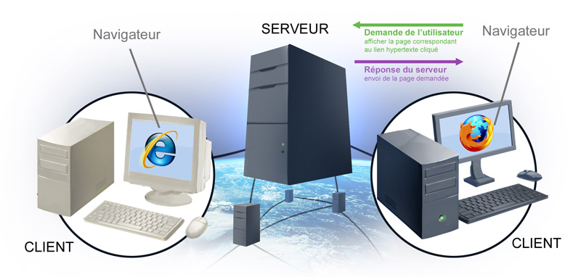

Slide 2
Protocol “Layers”
Networks are complex,
with many “pieces”:
  hosts
  routers
  links of various media
  applications
  protocols
  hardware, software
Question:
Is there any hope of organizing structure of network?
Or at least our discussion of networks?
Introduction 1-2

Slide 3
Why layering?
Dealing with complex systems:
explicit structure allows identification, relationship of complex system’s pieces
  Example: OSI reference model.
modularization eases maintenance, updating
of system
application
presentation
session
transport
network
link
physical
Introduction 1-3
Notes:
presentation: allow applications to interpret meaning of data, e.g., encryption, compression, machine-specific conventions
session: synchronization, checkpointing, recovery of data exchange

Slide 4
Internet protocol stack
application: supporting network applications
  FTP, SMTP, HTTP
transport: process-process data transfer
  TCP, UDP
network: routing of datagrams from source to destination
  IP, routing protocols
link: data transfer between neighboring network elements
  Ethernet, 802.111 (WiFi), PPP
physical: bits “on the wire”
application
transport
network
link
physical
Introduction 1-4

Slide 5
The objective of this course
This course is valuable for applications in client server architecture in the Internet. It describes the network protocols of upper layers with an orientation towards application protocols of the Internet architecture (eg protocols DNS, Telnet, SMTP, HTTP, SNMP, ...).

Slide 6
General plan
I - General introduction
II - Distributed programming
III - Client-Server applications in the internet

Slide 7
I - General introduction
First part (I) (2 lectures)
General information on client-server architectures and distributed on the Internet architecture layers high.

Slide 8
II – Distributed programming
Second part (II)
JAVA: TCP/UDP sockets. Multithreading. Internet Addresses. Remote Metthod Invocation.

Slide 9
III- Client/Server applications on the Internet
Third part (III) We chose the following applications:
1- HTTP/HTTPS protocols
1- Distributed directories: an example directory DNS.
2- Remote access protocols : an example TELNET.
3- Messaging: an example SMTP protocole (MIME format), POP3.
4- Protocol file transfer and file systems distributed: an exemple FTP , NFS or FTAM protocol.

Slide 10
Application architectures
client-server
peer-to-peer (P2P)
hybrid of client-server and P2P
Application 2-10

Slide 11
Some network apps
e-mail
web
instant messaging
remote login
P2P file sharing
multi-user network games
streaming stored video (YouTube)
voice over IP
real-time video conferencing
cloud computing
…
…
Application 2-11

Slide 12

Client-server architecture
server:
  always-on host
  permanent IP address
  server farms for scaling
clients:
  communicate with server
  may be intermittently connected
  may have dynamic IP addresses
  do not communicate directly with each other
client/server
Application 2-12

Slide 13
Pure P2P architecture
no always-on server
arbitrary end systems directly communicate
peers are intermittently connected and change IP addresses
highly scalable but difficult to manage
peer-peer
Application 2-13

Slide 14
Hybrid of client-server and P2P
Skype
  voice-over-IP P2P application
  centralized server: finding address of remote party:
  client-client connection: direct (not through server)
Application 2-14

Slide 15
Client/Sever
Client / Server
The term Client/Server was first used in the 1980s.
The term Client/Server is in reality a logical concept.
A single machine can be both a client and a server depending on the software configuration.
The Client and server components may not exist on distinct physical hardware
The Client/Server technology is a model, for the interaction between simulaneously executing software process.

Slide 16
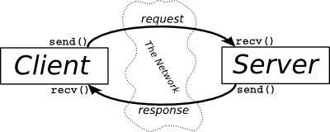
Client / Server ?
What’s Client Computing ? | What’s Server computing ?
A Client is any process that requests specific services from the server process. Client can request services from several servers on the network without regard to the location or the physical characteristics of the computer in which the Server process resides. The client is a consumer of services | A Server is a process that provides requested services for the Client. The Server can provide services for more than one Client. The server process is a provider of services.
Client and Server Processes can reside in same computer or in different computers linked by a network.

Slide 17
The different types of Server
The type of servers
Web Server: This machine stores ande retrieves Internet (and Intranet) data for the entreprise. Some documents, data, etc. reside on web servers. Web application provides access to documents and other data.
Mail Server: This machine manages the flow of electronic mail, messaging, and communication with mainframe systems on large-scale networks.
File Server: provides clients access to records within files from the server machine. (ex: NFS in Unix, « Map Drive » in Microsoft Windows )
Database Server : Data resides on server, in the form of a SQL database. It provides access to data to clients, in response to SQL requests. It receives SQL requests and processes them and returning only the requested data. (Oracle9i database server)
Application Server: This machine manages access to centralized application software; for ex. shared database…etc. ( Print Server, Fax Server, Directory Services Server, Transaction Servers, Groupware Servers et Object Apllication Servers…)

Slide 18
Characteristics of the Client/Server systems
Service : The client/server is primarily a relationship between process runing on separate machines.
Shared Resources : A server can service many clients at the same time and regulate their access to shared resources.
Asymmetrical protocols: There is a many-to-one relationship between the clients and the server. Clients always initiate the dialog by requesting a service.
Transparency of location: The server is a process that can reside on the same machine as the client or on a different machine across a network. A program can be a client, a server, or both.
Mix-and-match: The ideal client/server software is independent of hardware or operating system software platforms. You should be able to mix-and-match client and server platforms.

Slide 19
Characteristics of the Client/Server systems
Message-based exchanges: Clients and servers are loosely coupled systems that interact through a message-passing mechanism. The message is the delivery mechanism for the service request and replies.
Integrity : The server code and server data is centrally managed, wich results in cheaper maintenance and the guarding of shared data integrity.
Scalability: Client/server systems can be scaled horizontally or vertically. Horizontal scaling means adding or removing client workstations while keeping a high standard of performance. Vertical scaling means migrating to a larger and faster server machine or a multi server.

Slide 20
Client/Server - Advantages
Advantages
System administration (centralized management).
Location independence of data processing
Integrated services
Performance and reduced workload
Workstation independence
System interoprability
Data integrity , Data accessibility
Sharing ressources among diverse platforms
Reduced operating, hardware and communication costs

Slide 21
Disadvantages
If too many customers want to communicate with the server at the same time, it may not support the load.
If the server is not available, customers no longer does.
Costs of implementation, maintenance, hardware, Training, Software are high.

Slide 22
Client / Server functions
The main operations of the client system are listed below:
Managing the user interface
Accepts and checks the syntax of user inputs
Process application logic
Generates database request and transmits to server
Passes response back to server

Slide 23
Client / Server functions
The main operations of the server system are listed below:
Accepts and processes database requests from client
Checks autorisation
Ensures that integrity constraints are not violated
Performs query/update processing and transmits responses to client
Maintains system catalogue
Provide concurrent database access
Provides recovery control

Slide 24
Classification of Client/Server systems
There are different types of Client/Server systems in existence:
Two-tier Client/Server Model
Three-tier Client/Server Model

Slide 25
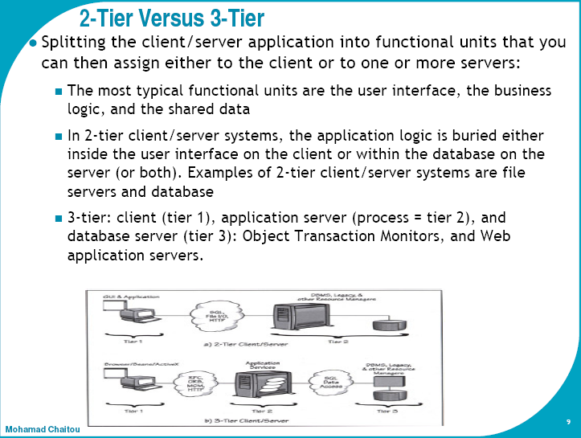

Slide 26
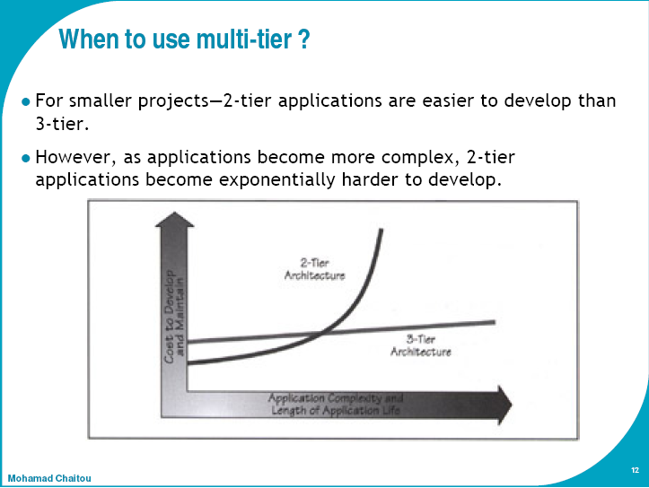

Slide 27
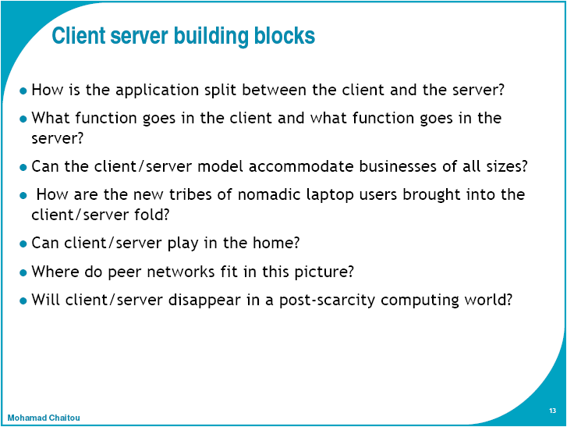

Slide 28
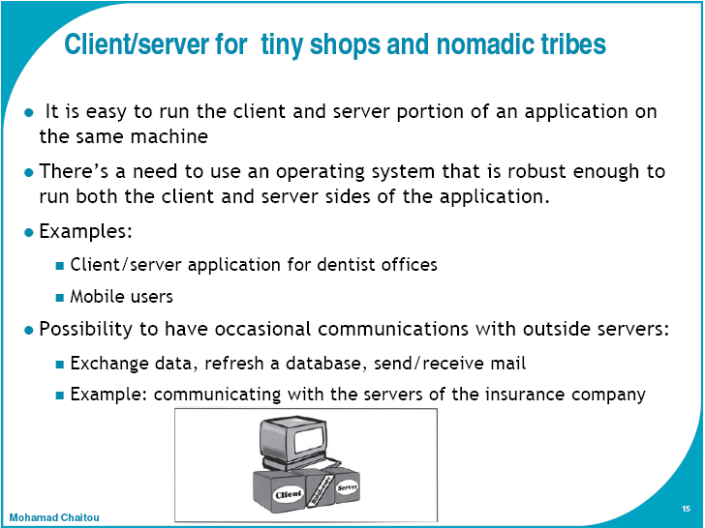
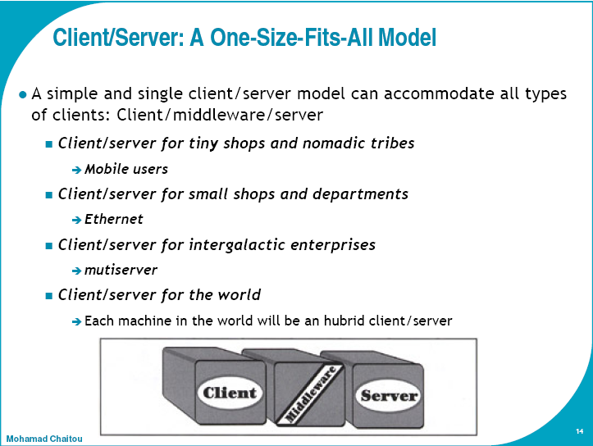

Slide 29
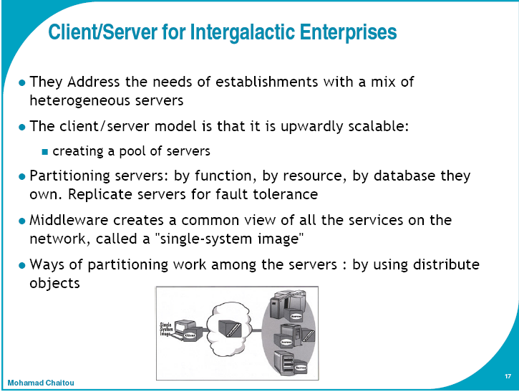

Slide 30
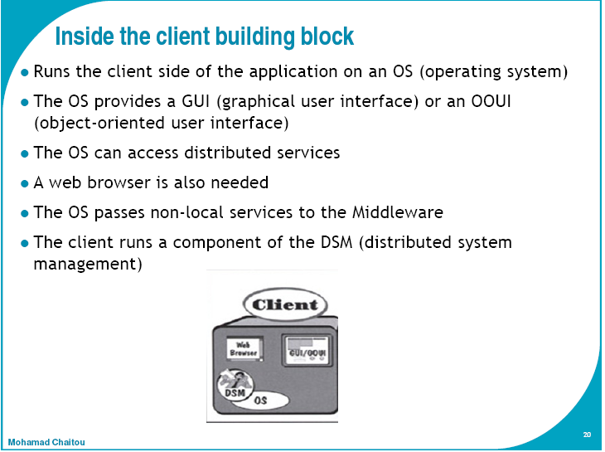

Slide 31
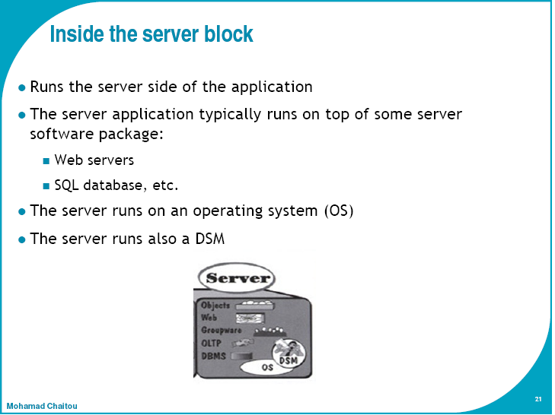

Slide 32
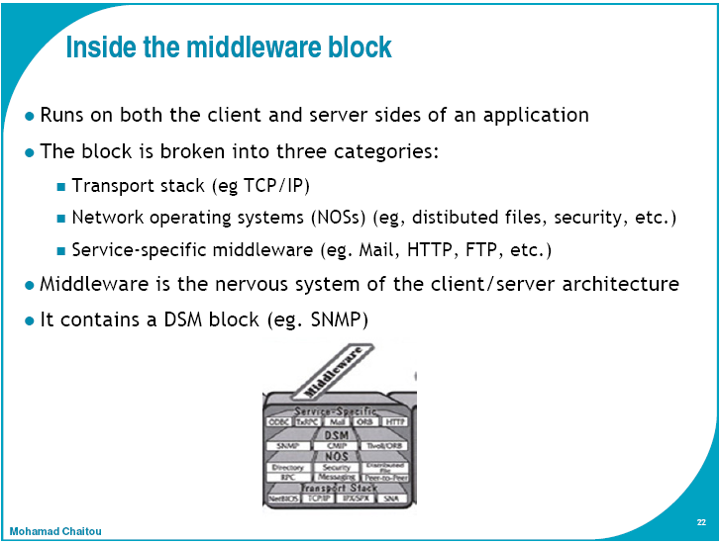

Slide 33
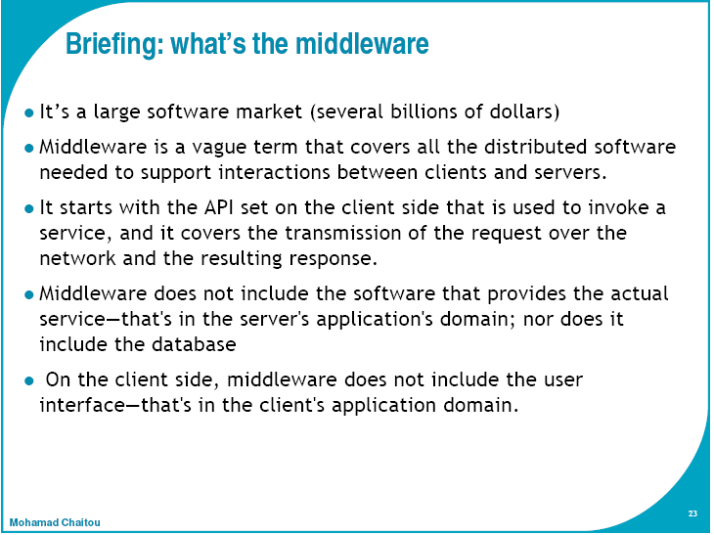

Slide 34
Proverb of the day
“When planning for a year, plant corn.
When planning for a decade, plant trees.
When planning for life, train and educate people.”

